Slide 1
Heart Disease Prediction
A Gen AI Sprint Powered by Data
Hackathon 2025

Slide 2
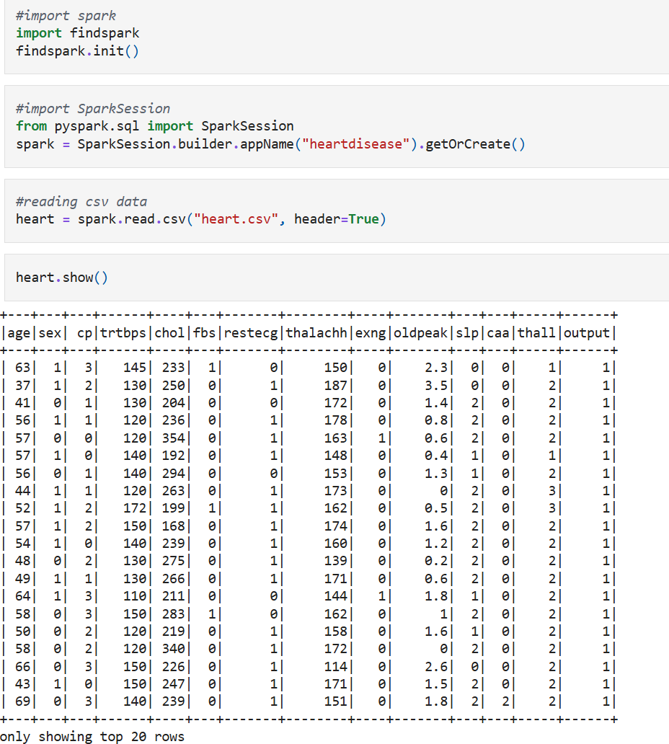
Retrived the data into the table using Spark

Slide 3
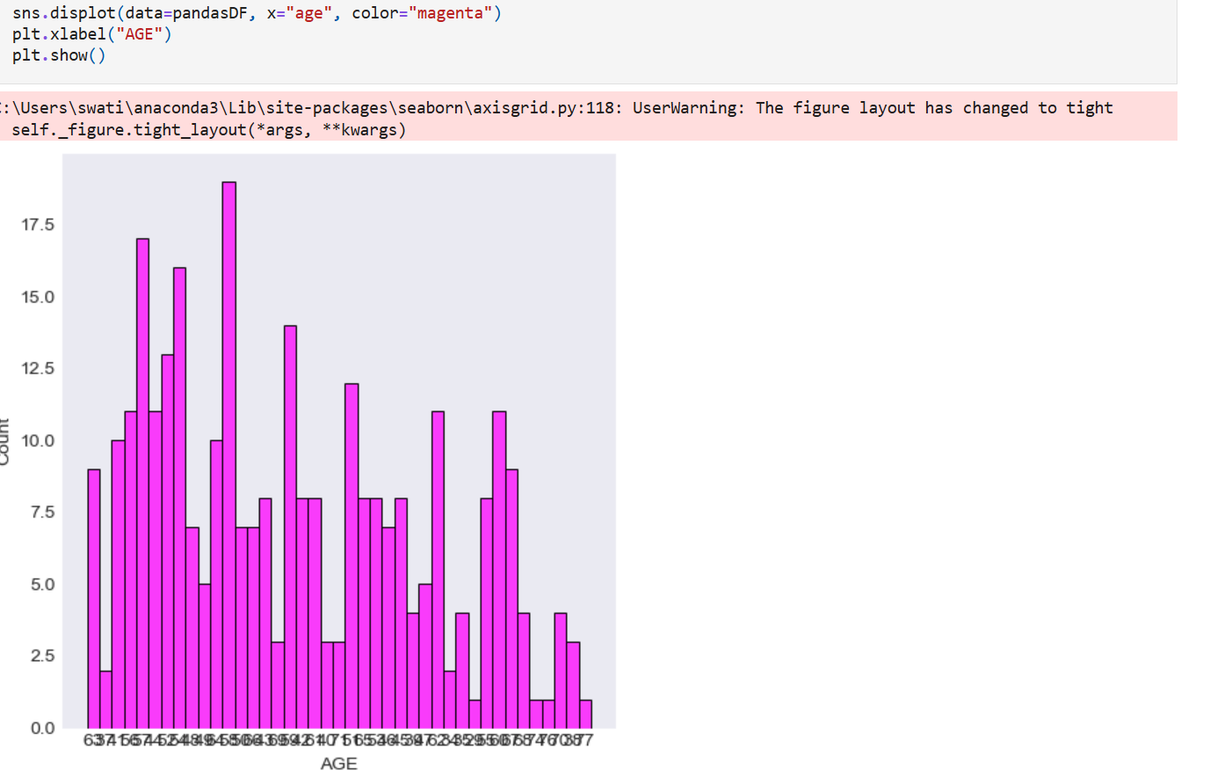
Count of patients with heart disease prediction based on age

Slide 4
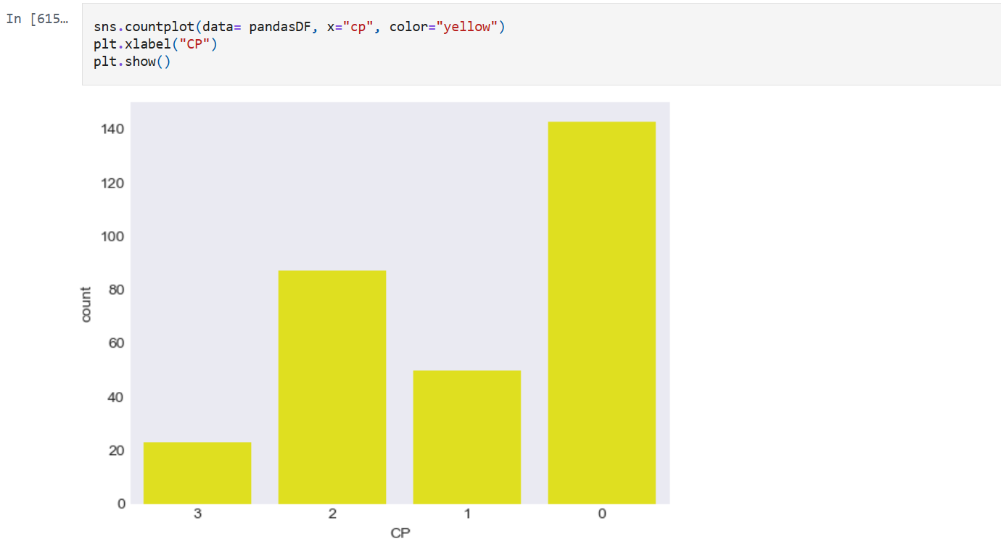
Count of people having heart disease using chest pain

Slide 5
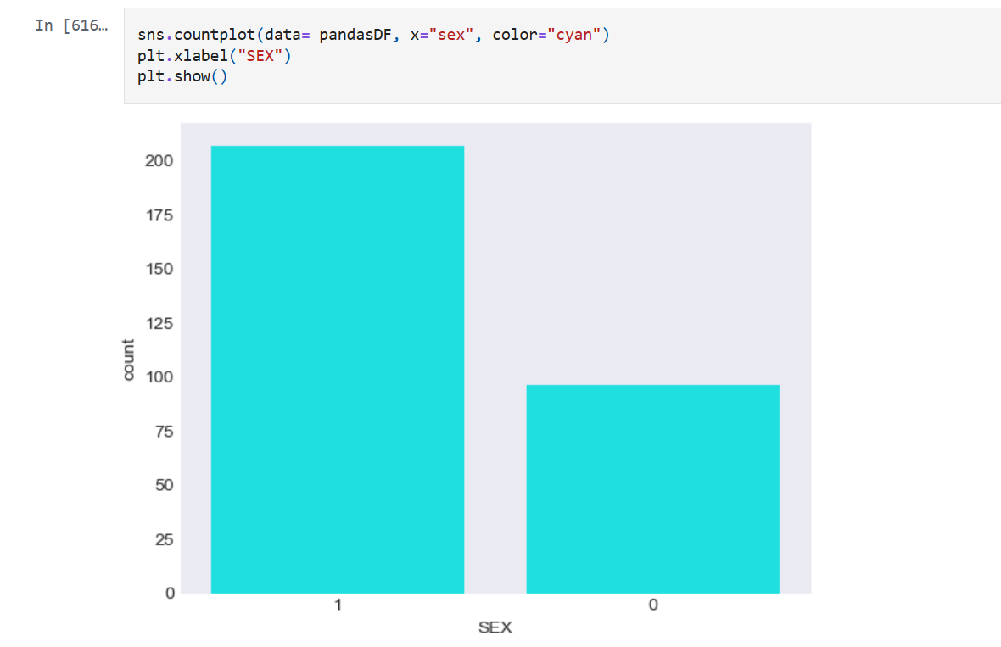
Count of people with heart disease using sex 1 = male, 0= female

Slide 6
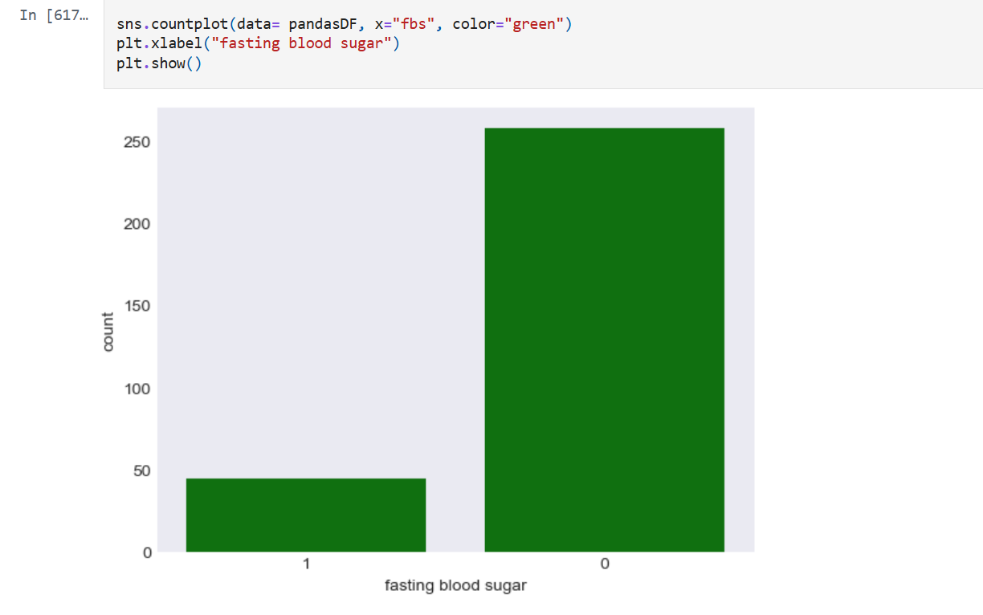
Count using fasting blood sugar and based on gender

Slide 7
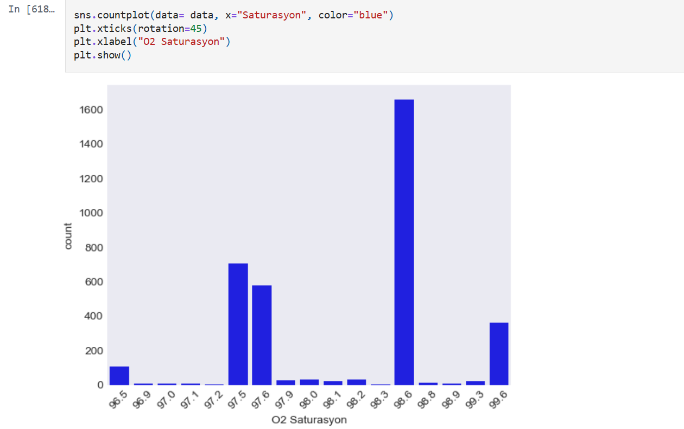
Count of patients based on oxygen saturation

Slide 8
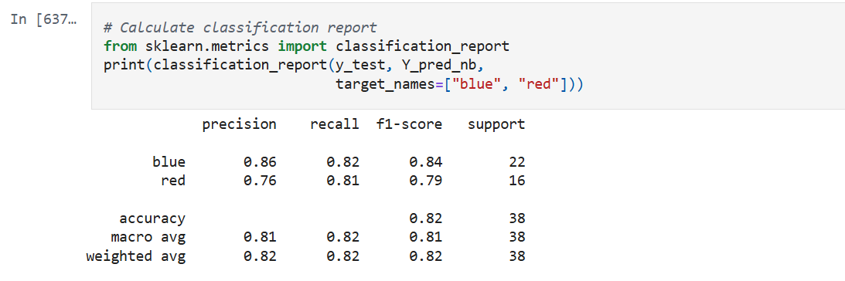
Naive Bayes

Slide 9
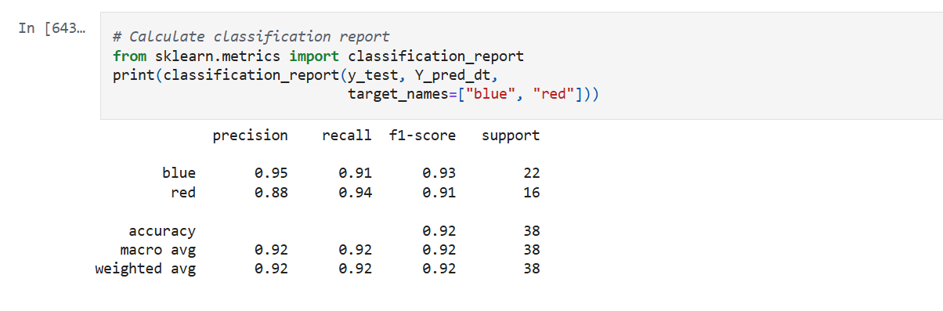
Decision Tree

Slide 10
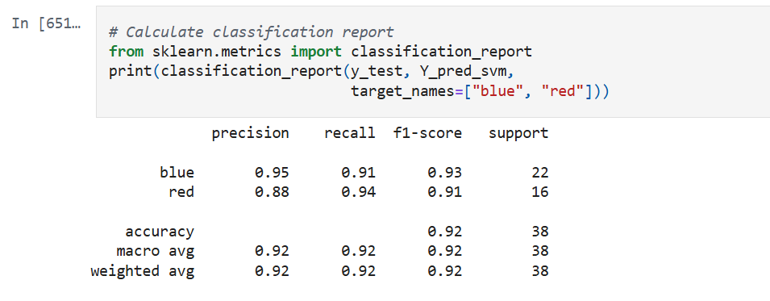
KNeighbors
The accuracy score achieved using KNN is: 60.53 %

Slide 11
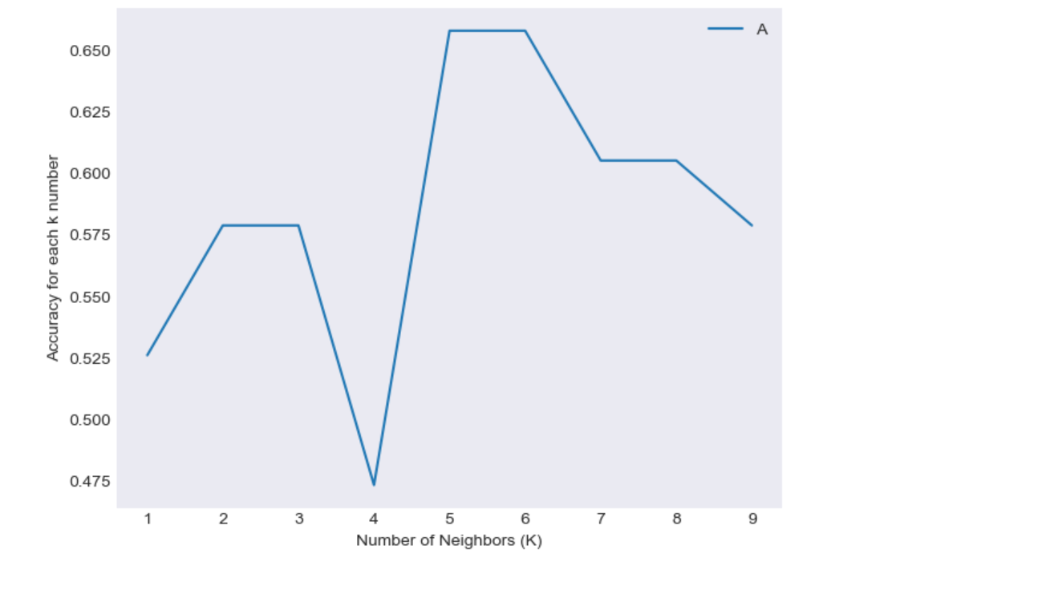
KNeighbors

Slide 12
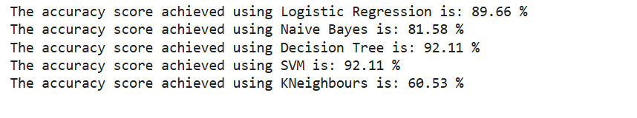
Output final score

Slide 13
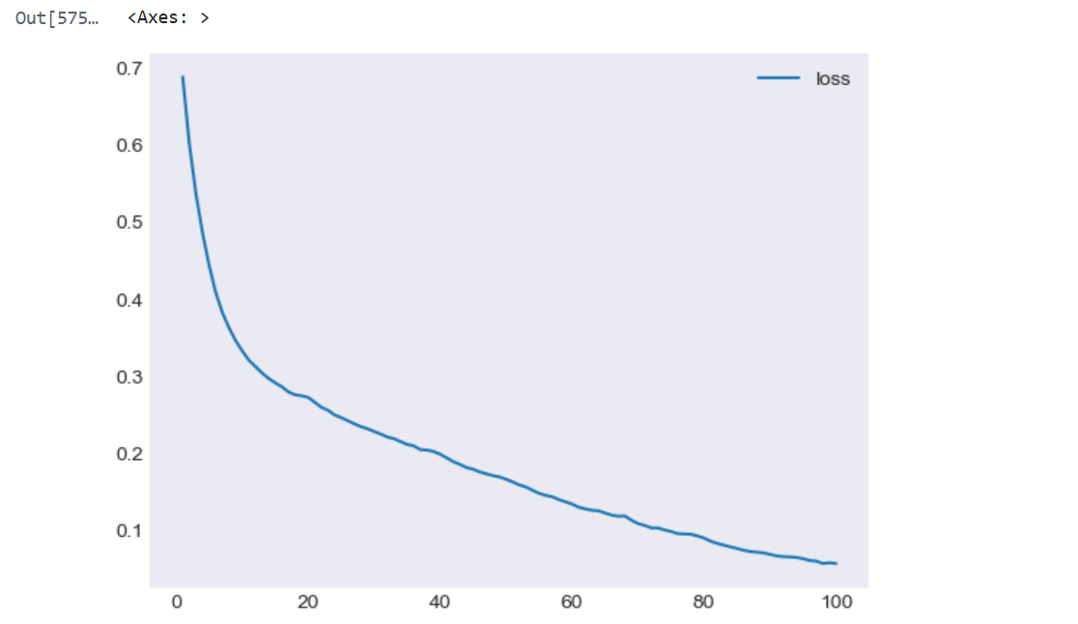
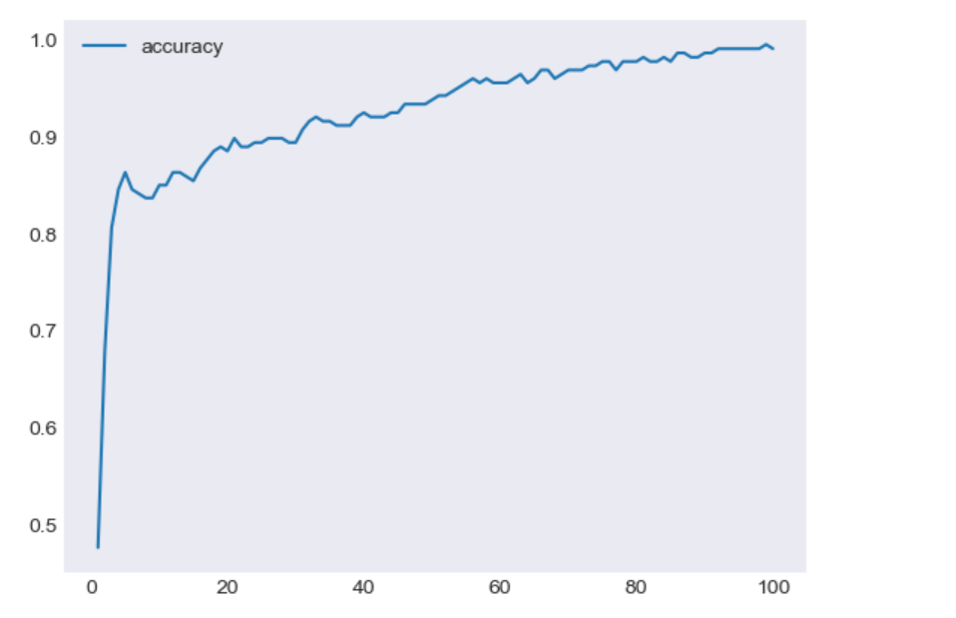
Neural Network

Slide 14
Conclusion :
This is not bad, however depending on the context of where this ML pipeline will be utilized, it might be best to sacrifice accuracy in favor of recall or precision optimization. In the event the goal is to provide doctors or patients with a tool to identify heart attack risk in every patient who has a true value of "risk", it might be best to ensure the recall is as close to 100% as possible.
While this is a very popular dataset on Kaggle, and served as a great training dataset in a class setting, there was no source or explanation on where the data came from. It could have been randomly generated or from a single hospital. Fortunately, this was constructed in a classroom setting for educational purposes and not for any real-world healthcare applications. Going forward, assessing the source of datasets before conducting projects or building ML pipelines will be critical.

Slide 15
Technologies Used
Pyspark
Pyspark.sql
Numpy
Pandas
Seaborn
Matplotlib.pyplot
Plotly
Jupyter
Python

